Slide 1
Machine Learning Project: Tennis Analysis

Slide 2
Agenda
ETL Process
Random Forest
End Point Tracking
Clustering
Conclusion

Slide 3
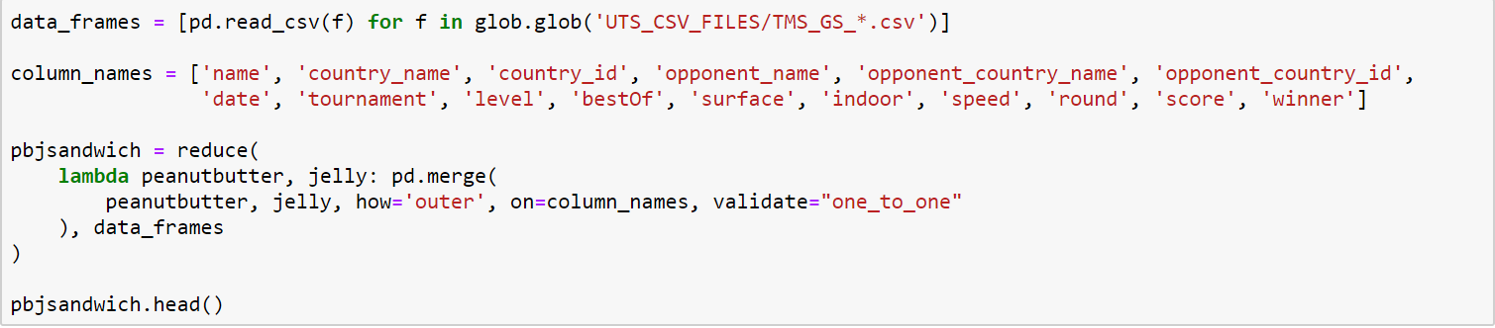
ETL Process
Find Datasets
UCI Tennis Major Tournament Match Statistics Data Set
https://archive.ics.uci.edu/ml/datasets/Tennis+Major+Tournament+Match+Statistics
Ultimate Tennis Statistics
https://www.ultimatetennisstatistics.com/
Create Data Frames
Loop through csv files and merge/concat
Create SQLite Database
Tennis_Collection.db
Add Data Frames to Database as Separate Tables
UTS_All
Mens_Tournaments
Womens_Tournaments

Slide 4
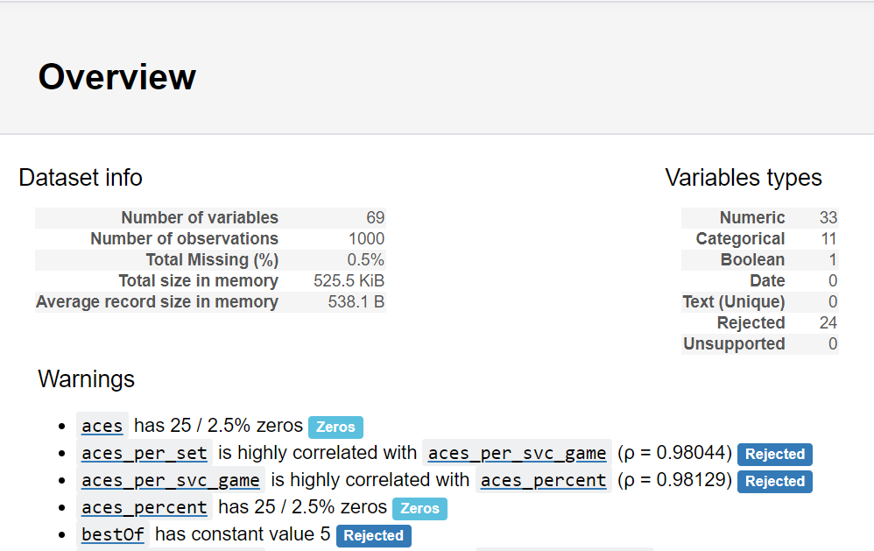
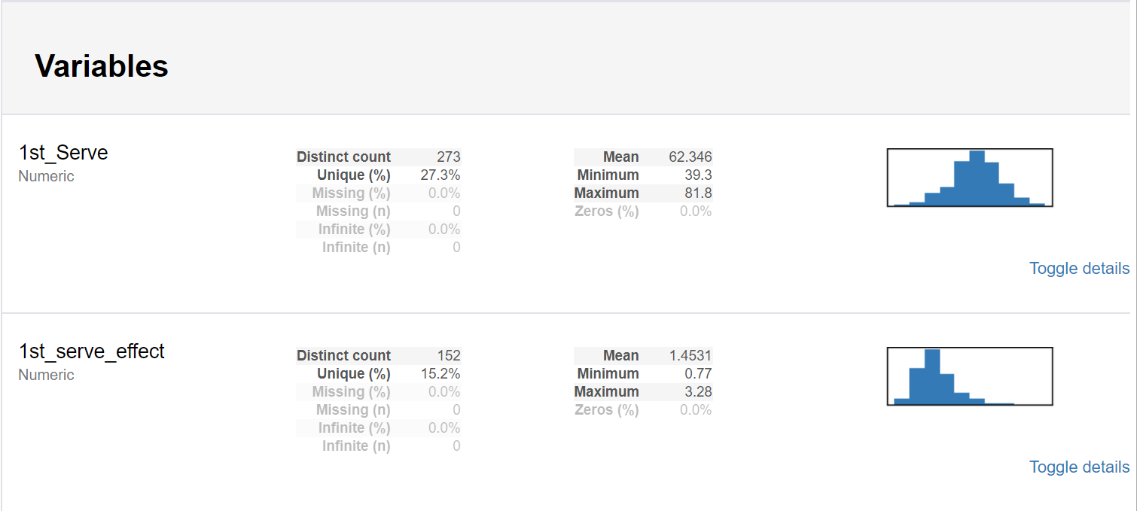
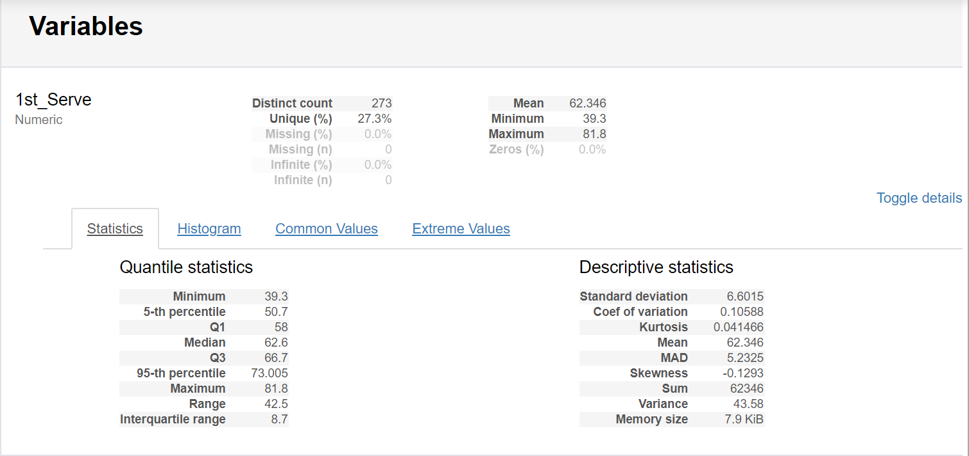
Pandas Profiling

Slide 5
Random Forest
Data Cleaning
Remove Null Values
Train Data
Random Forest

Slide 6
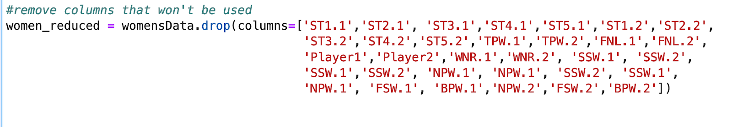
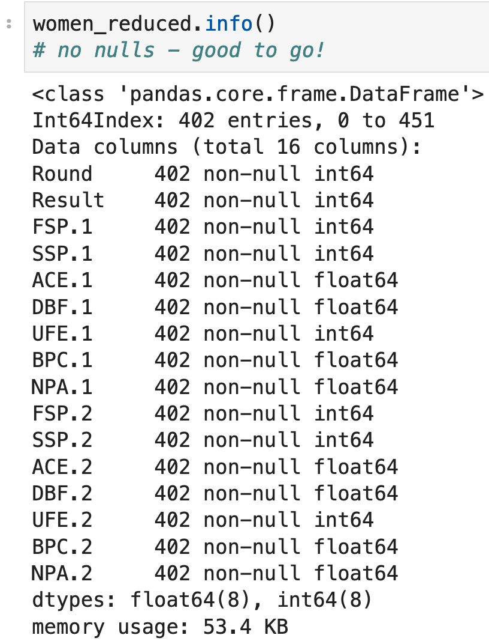
Data Cleaning
Drop Features
Unimportant
Highly correlated
Remove Null Values

Slide 7
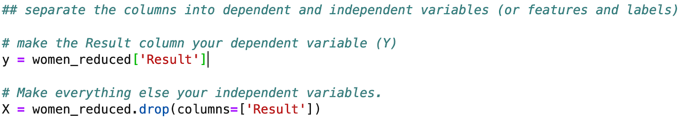
Train Data

Slide 8
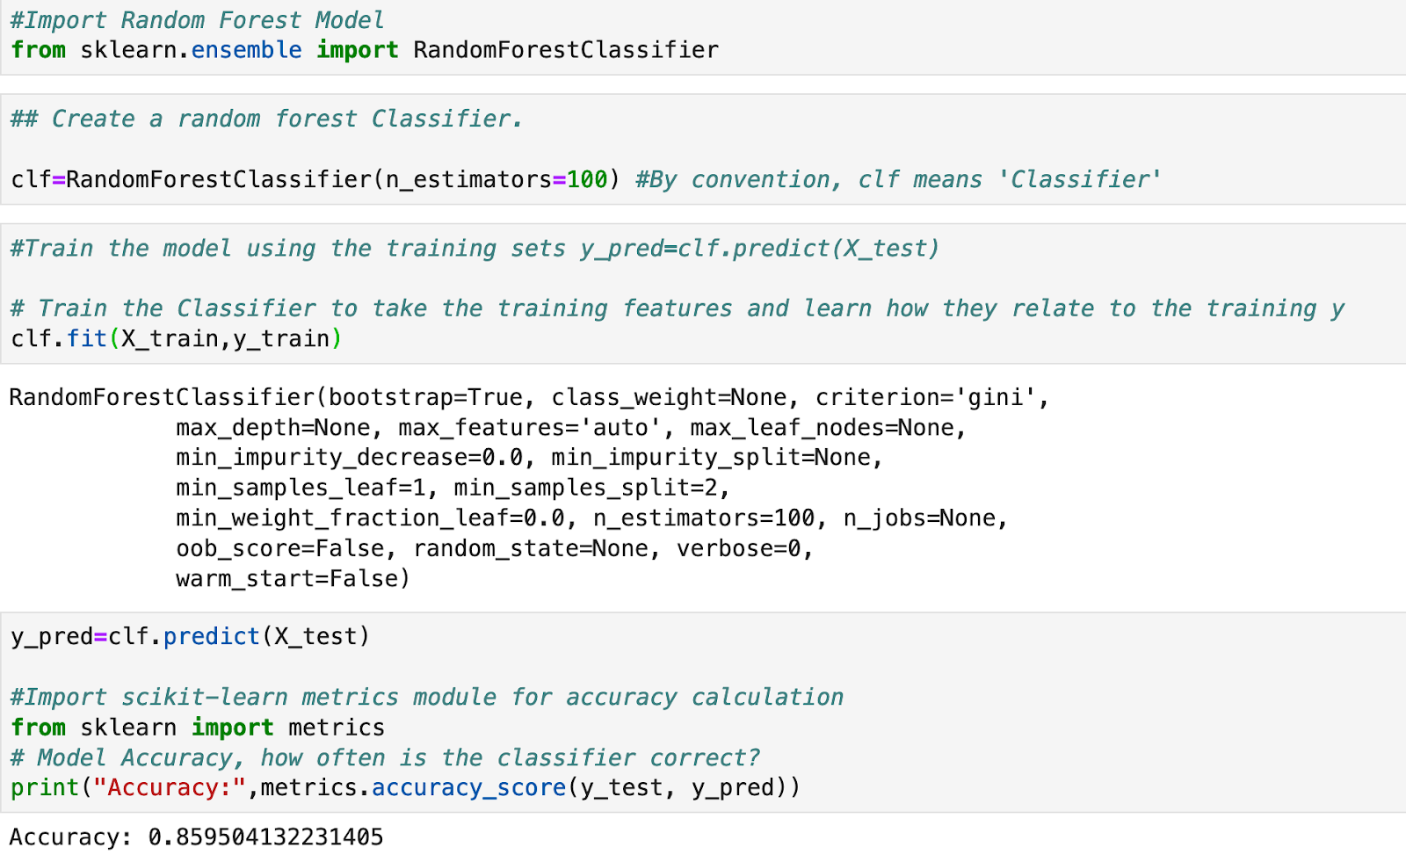
Random Forest
Accuracy: 86%

Slide 9
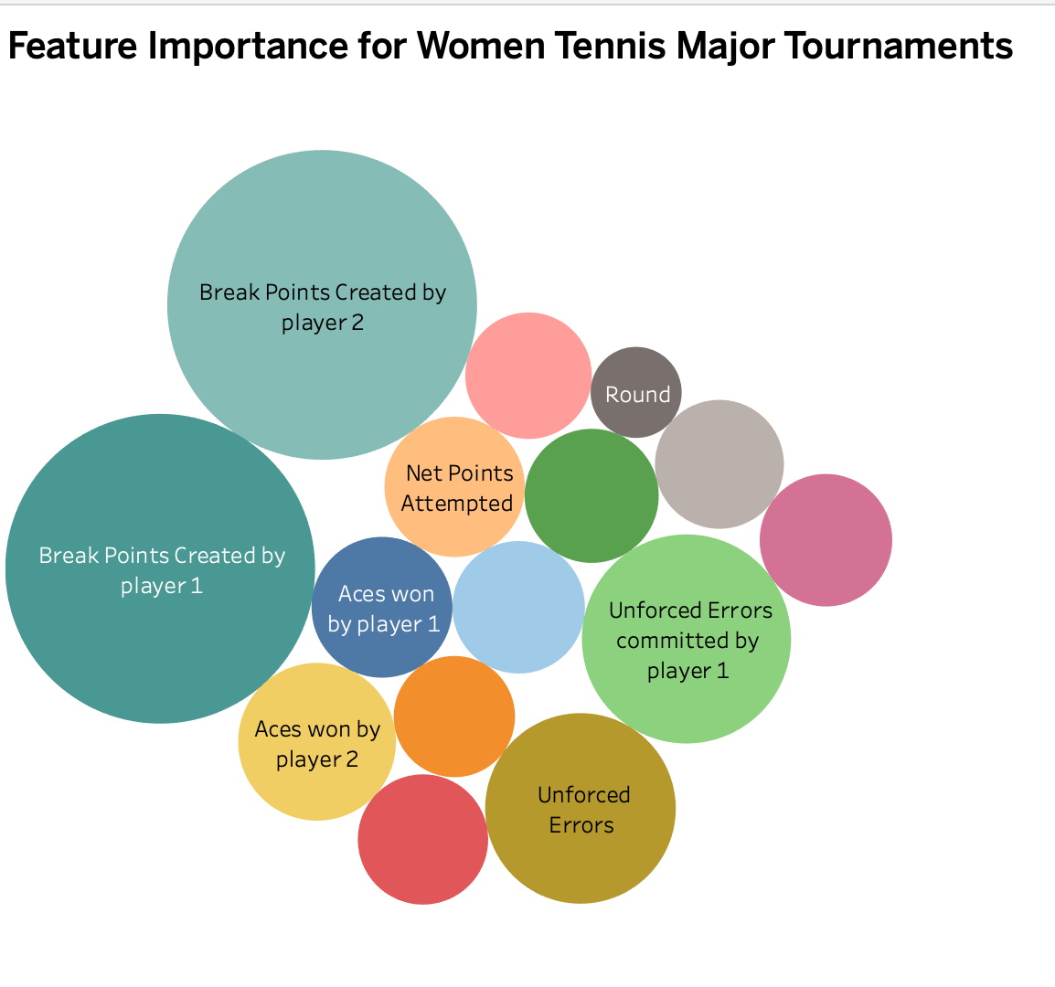
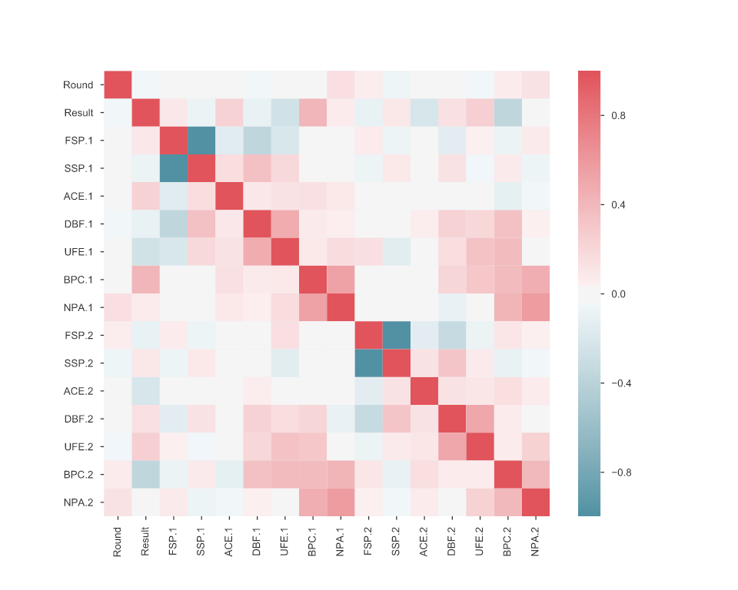
Feature Importance in Women's Tournaments
Tableu

Slide 10
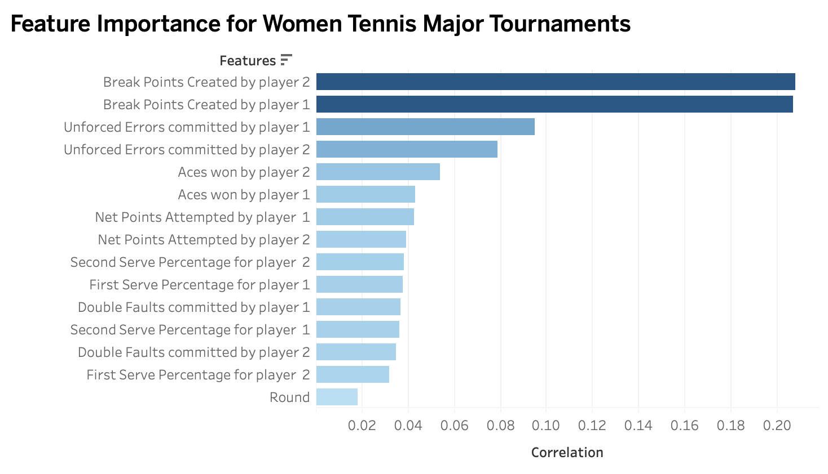
Feature Importance in Women's Tournaments
Tableu

Slide 11
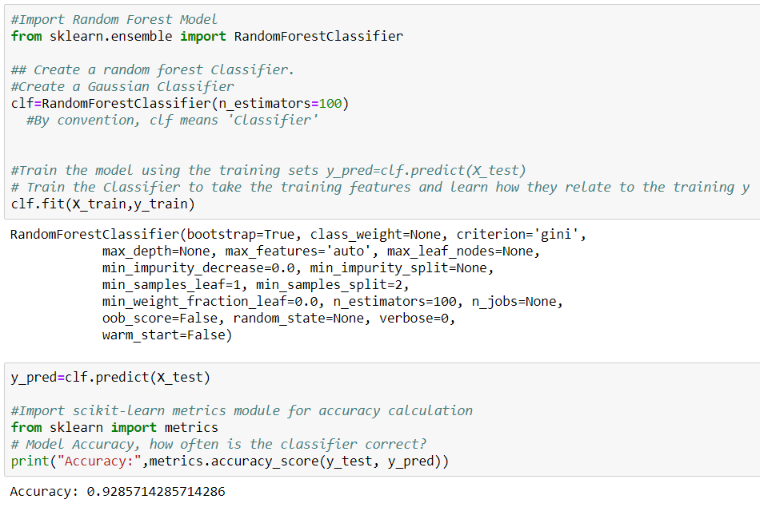
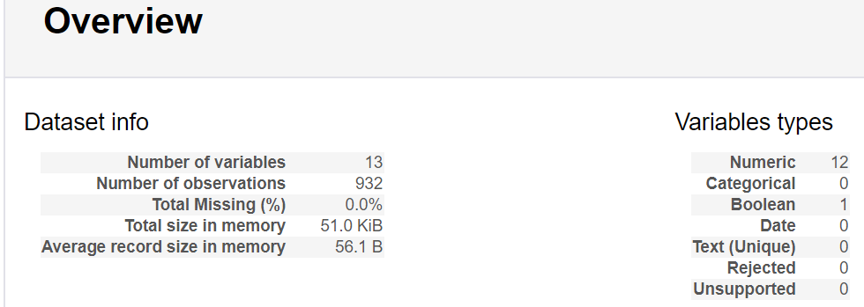
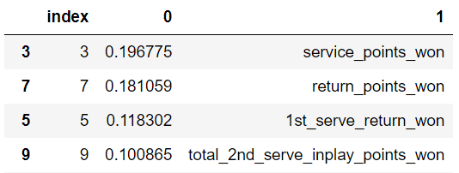
Feature Importance in ATP Tournaments
Accuracy: 92.8%

Slide 12
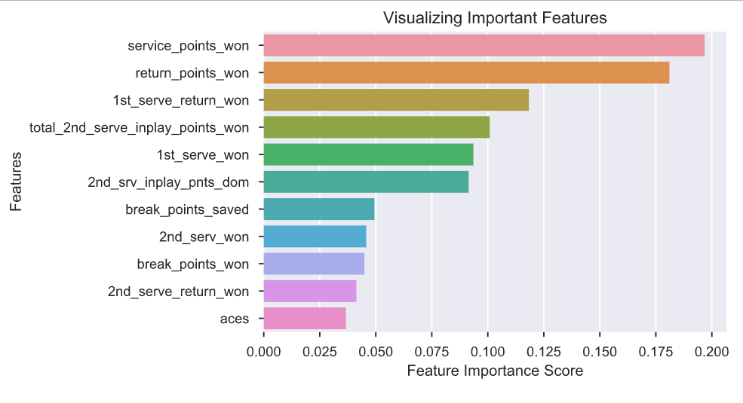
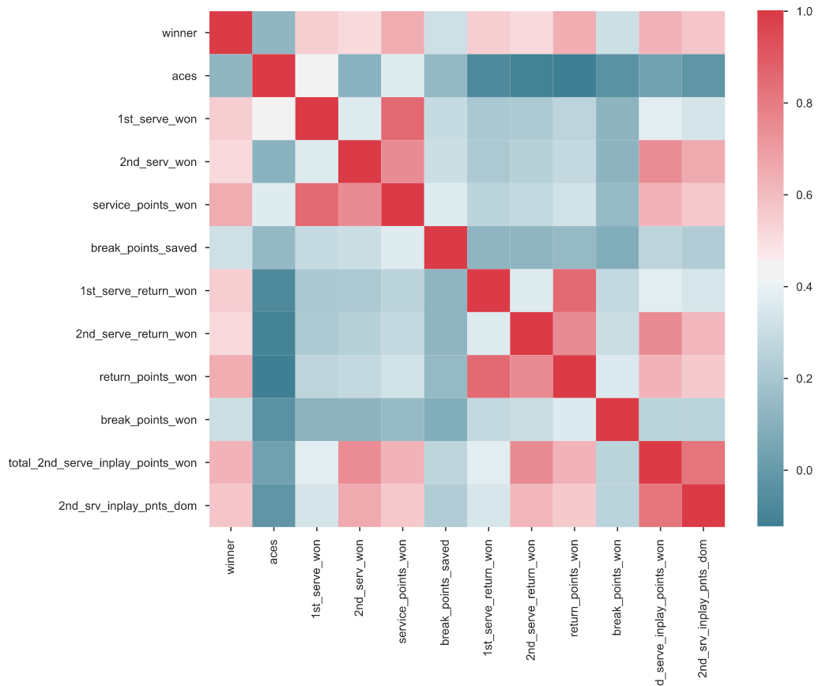
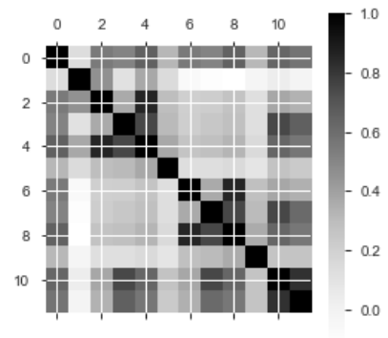
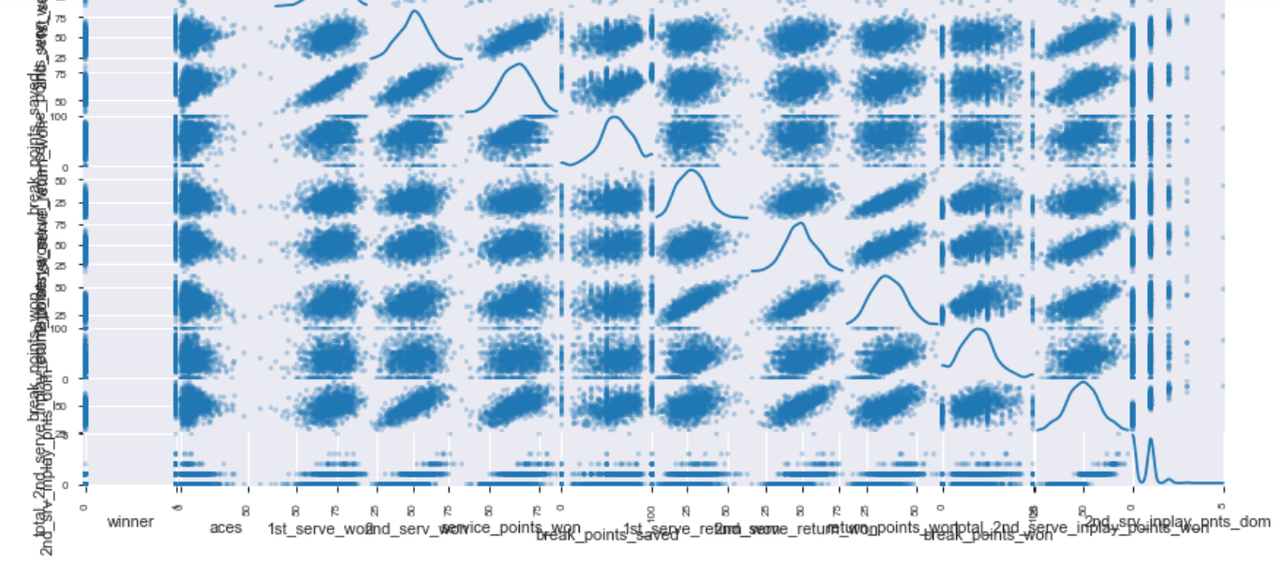
Feature Importance in ATP Tournaments
This is a pleasant sight:
This is not:

Slide 13
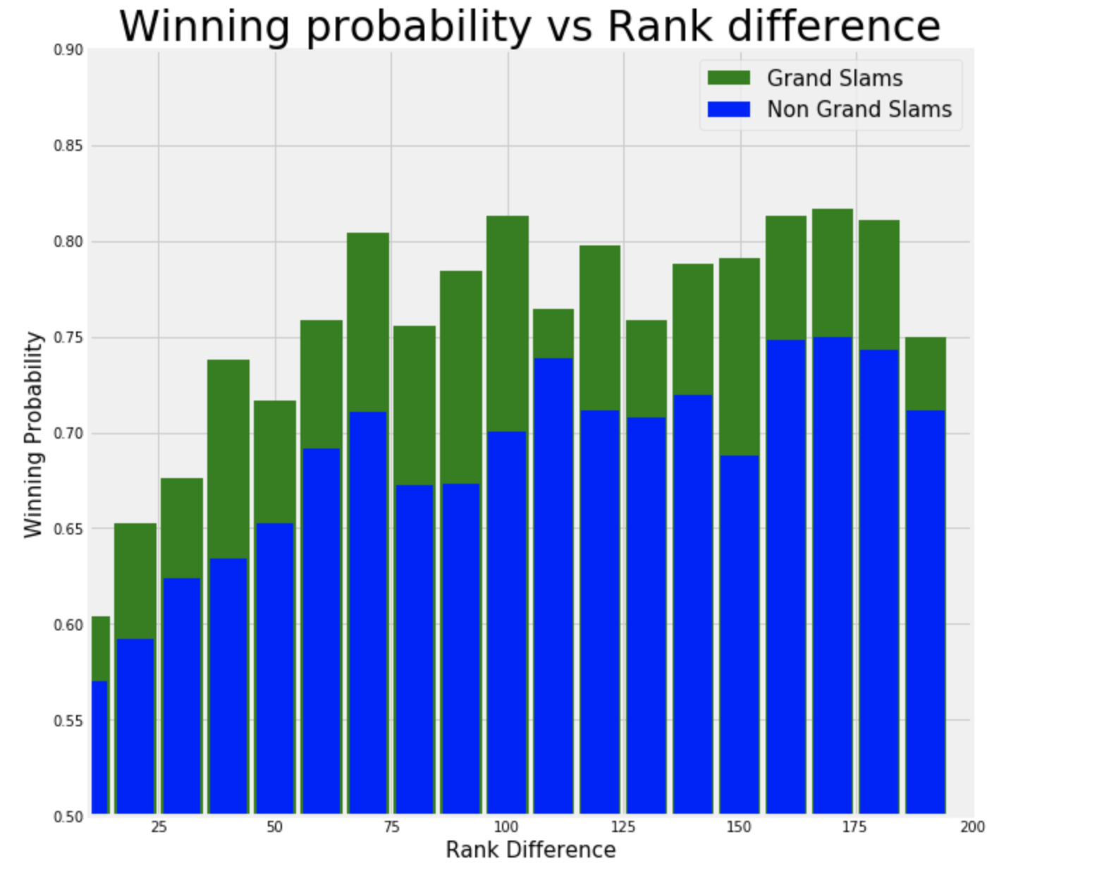
Winning Probability: GS vs. Non-GS
An upset is less likely in Grand Slam tournaments as it is in regular ones. A favorite player has a ~80% chance of winning when facing an underdog ranked 100 places below in a Grand Slam tournament, but only around 70% winning chances in a regular one.

Slide 14
Predicting Point End Using Tracking Data
Harish
To
Add
Steps

Slide 15
Predicting Point Ending Using Tracking Data (Harish)

Slide 16
Predicting Point Ending Using Tracking Data (Harish)

Slide 17
Clustering
Gathered major tournament match statistics from UCI
Designed Alteryx workflow to clean up data and organize match statistics by player
Utilized python tool within Alteryx to determine clusters
Summarized data uploaded to Tableau server

Slide 18
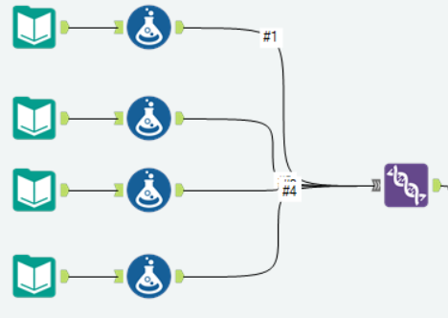
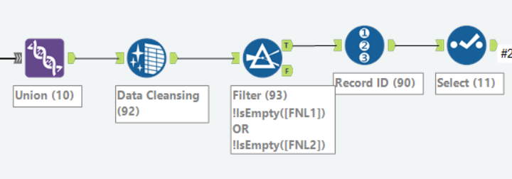
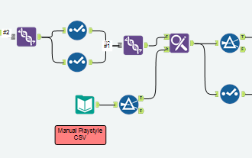
Data Cleanup (Alteryx)
Used formula tool to create new columns containing gender, name of tournament, and court surface (grass, clay, etc.)
Unioned major tournament data
Replaced null values in 'Final Games' columns with blanks, filtered out blank fields (drop n/a)
Assigned match a record ID
Selected essential data fields to
carry forward in workflow
Separated, and rejoined individual player data from matches to condense 'Player 1' and 'Player 2' fields into a single 'Player' field

Slide 19
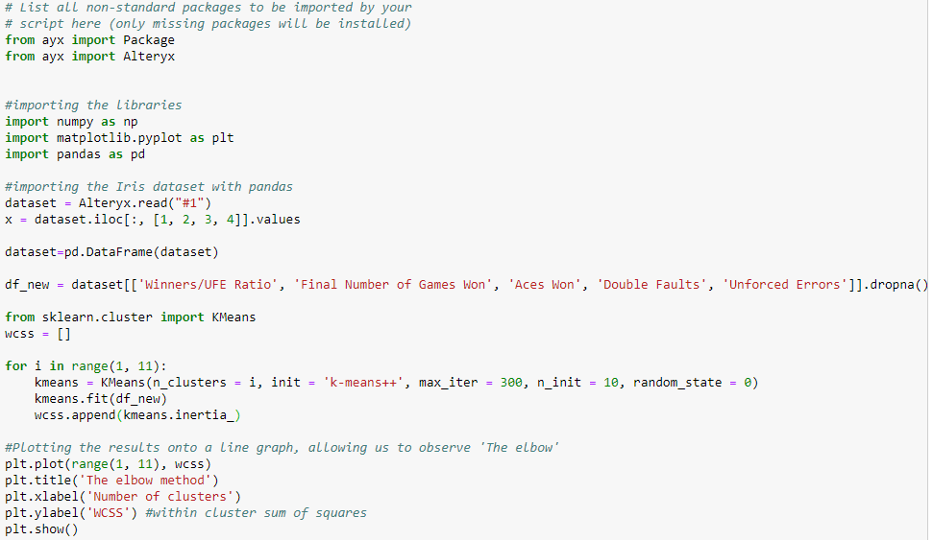
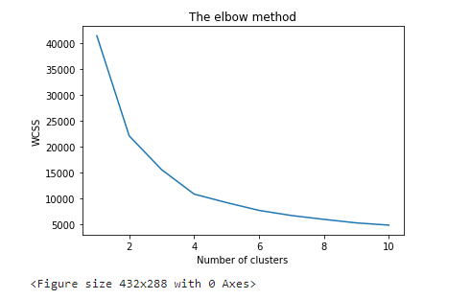
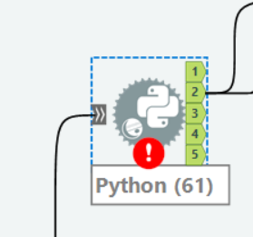
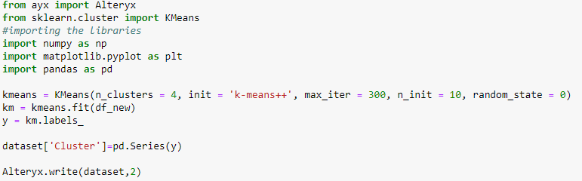
Clustering
Summarized player data plugged in to Python tool
Utilized Elbow method to validify optimal number of clusters
Use K-Means to cluster players

Slide 20
Playstyles
Aggressive Baseliner : An offensive or aggressive baseliner tries to control and dictate play by hitting powerful groundstrokes for winners usually from the area of the baseline or behind it. An effective offensive baseliner can overpower many opponents, however, when going for winners, they can also produce many errors since they have to repeatedly and correctly execute some difficult strokes.
Defensive Baseliner : A defensive baseliner tries to return every ball and relies on the opponent making mistakes. The trademarks of a counterpuncher include consistent shots with low error rate, as well as precise placement that makes it hard for their opponent to execute an aggressive shot.
Server & Volleyer : A serve and volleyer has a great net game, is quick around the net, and has a fine touch for volleys. Serve and volleyers come up to the net at every opportunity when serving. They are almost always attackers and can hit many winners with varieties of volleys and drop volleys.
All Court : All-court players, or all-rounders, have aspects of every tennis style, whether that be offensive baseliner, defensive counter-puncher or serve-and-volleyer. All-court players use the best bits from each style and mix it together to create a truly formidable tennis style to play against. In game situations they are very versatile; when an all-court player's baseline game is not working, he/she may switch to a net game, and vice versa. All-court players have the ability to adjust to different opponents that play different styles more easily than pure baseliners or serve and volleyers.
Aggressive Baseliner
Mayer
Matosevic
Nadal
Dewarman
Kyrgios
Delbonis
Federer
Isner
Djokovic
Raonic
Johnson
Thiem
Paire
Defensive Baseliner
Server & Volleyer

Slide 21
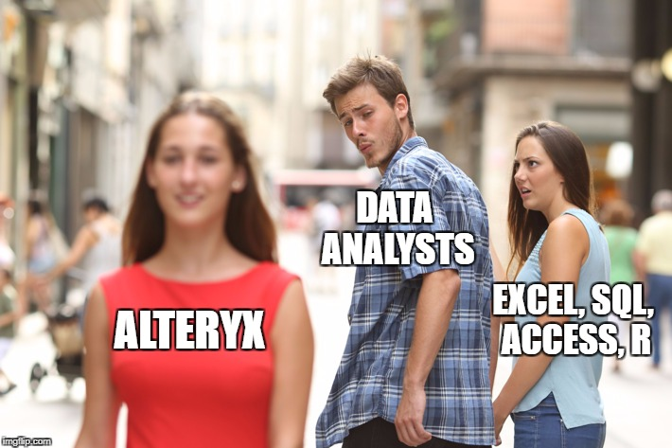
Conclusion
Points
Made
Questions?

